Slide 1

11/28/18 Meeting Update
Post-Thanksgiving stressing

Slide 2
Agenda
We took a breather over Thanksgiving (did work for other classes)
Power
Buck boost converter, fuel gauge, LDOs arrived
Problem #1: programming fuel gauge (Brady)
Problem #2: outdoor battery charging (Rachel)
Progress
What’s left?
What should we do to prepare for the prototype presentation (besides make it work)?

Slide 3
Power
Parts arrived
Sharing the fuel gauge programmer with the Wireless Neural Recording team
Issue: Software was incompatible with hardware, but turns out it was the wrong software
Planning to program fuel gauge over the next few days, then LDOs should just pop in
Something’s up with our charger
Battery keeps oscillating
It has been doing this, but I originally thought it was normal. Now I’m not so sure
Plan A: contact an apps engineer. Plan B: find different energy harvester for prototype 2
Collected more data outside
Problems at first getting drivers to work, but now functioning
Already collected data in the shade. Soon will collect data in direct sunlight
Should allow us to finish characterizing our power system

Slide 4
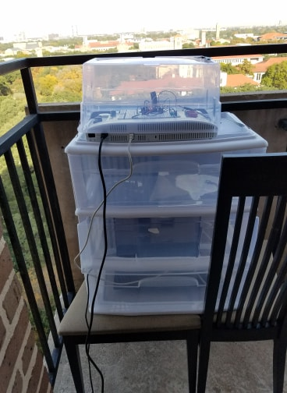
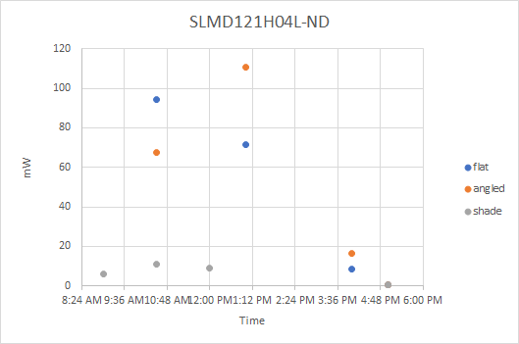
Solar Cells
(Sorry it’s not a curve)

Slide 5
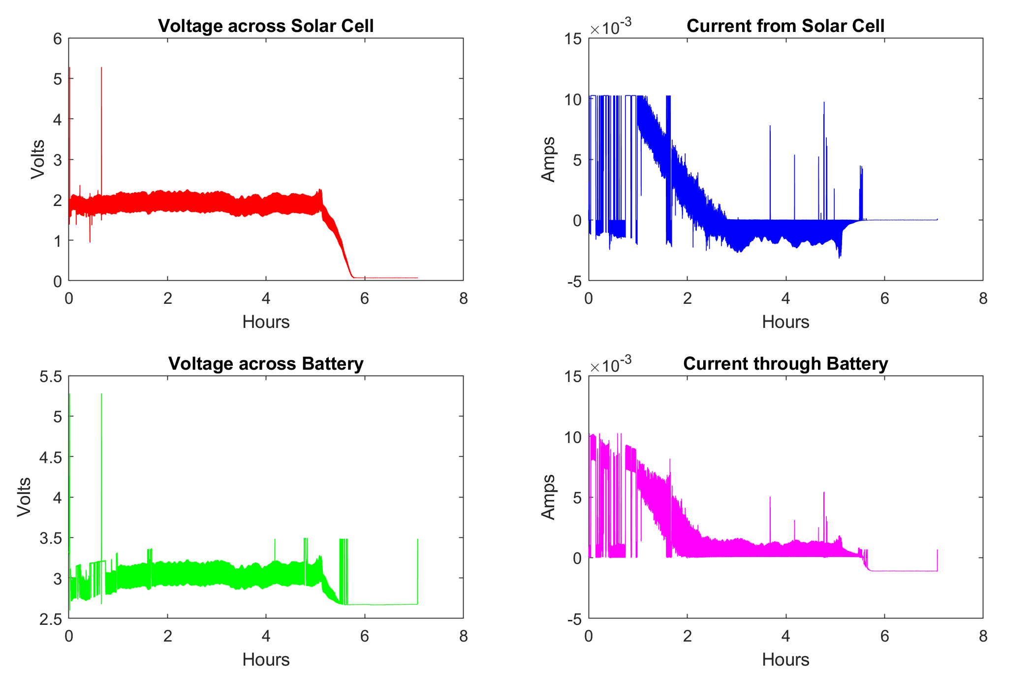
Battery Charging
Data collected in shade (sunny day overall)
9:00 am-7:45 pm
Labview glitch during initial 2 hours
3.002 V → 3.457 V
Next steps
1) reproduce weird behavior
or 2) collect better data

Slide 6
Solar Cells
Bigger solar cells?
Solar Cell | Size | Power (mW)
SLMD121H04L-ND (current one) | 43MM x 7MM | 89
SLMD600H10L-ND | 22MM x 35MM | 111
SLMD480H12L-ND | 35MM x 22MM | 109
SLMD121H10L-ND | 42MM x 35MM | 223

Slide 7
More BLE Power Data
See power Document for the data
https://docs.google.com/document/d/111McvpkfxrFAivys9zhVATOuUiXMHiGPcLr7ZAXxH_M/edit

Slide 8
Wrapping up the semester
Code:
Waiting on programmed fuel gauge to have conditional transmission
Writing to FRAM (debugging)
Power Characterization Report
In progress
Preparing for next semester
Making lists of parts needed for prototype 2
Thinking about PCBs and schematics

Slide 9
Objectives for Cycle 2
Related Specifications | Objective | Potential Points (<=300) | Graded Points
Spec 1 | Acquire and store temperature/humidity sensor data using MSP430 (working I2C communication) | 200
Spec 2 | Working bluetooth data transmissions to a computer or phone | 300
Spec 2 | Communication range of at least 5 meters | 300
ALL | Characterize power requirements for temperature/humidity sensor (peak, average, and duration of current draw) | 150
ALL | Characterize power requirements for BLE chip (peak, average, approximate duration of current draw) | 150
Spec 3 | Power system can charge battery, monitor power availability, provide appropriate voltage rails to system | 200
Spec 4 | Characterize battery performance (charge cycle, etc.) | 150
Spec 3 | Characterize solar cell performance under different conditions (indoor, outdoor, etc.) | 150
Spec 5 | MSP430 able to schedule Tx based on power availability | 100
Spec 8 | The final components (not counting eval boards) used in prototype 1 cost less than $200 | 300
 | TOTALS (=2000) | 2000

